Slide 1


| Tech Management, SRI-B
CLASH OF THE
CLAWS
The OpenClaw Hackathon
20th April – 20th May 2026
Prizes worth ₹80,000

Slide 2
INTRODUCTION
Track History
🦞
🤖 AI Agent Branch
Launched as Clawdbot — Nov 2025
Rebranded to Moltbot
Became OpenClaw — Jan 2026
247K+ GitHub stars by Mar 2026
Founder Peter Steinberger joined OpenAI (Feb 2026)
Now governed by OpenClaw Foundation

Slide 3
CORE CONCEPT
AI Sovereignty — The Lobster Way
🪣
🧠
📜
The Tank
The Food
The Rules
User's Hardware
LLM API Keys
SOUL.md File
Mac mini, VPS, or homelab server. The environment the agent lives in.
Anthropic (Claude), OpenAI (GPT-4), or local DeepSeek/Llama model.
Plain-text personality & behavioral boundaries defined by the user.
📁 Local Markdown & YAML storage — fully inspectable
🔁 Always-on persistence — survives restarts & resets
🔒 No vendor lock-in — swap LLM without losing memory
Notes:
Local models: 40 billion parameters doesn’t work. Might need 300 billion Param
Caffeinate – Mac Mini function needs to be defined and enabled.
Soul.md, agents.md, user.md, heartbeat.md

Slide 4
FEATURES
Multi-Channel Autonomy
🌐 Supported Channels
💓
Proactive Heartbeat
Background daemon reads HEARTBEAT.md and acts autonomously — sending reminders or news digests without being prompted.
WhatsApp
Telegram
Discord
iMessage
🧠
Durable Memory (Cognitive RAM)
Slack
Signal
Pages relevant context from disk into the LLM window as needed. Handles projects beyond single-session limits.
Teams
Matrix
📎
Media & Document Support
Twitch
Google Chat
Processes and sends images, audio, and files. Supports Live Canvas (A2UI) for dynamic interactive dashboards.
Notes:
Time sensitive – heartbeat is used
Most people disable heartbeat and enable cron jobs

Slide 5
ARCHITECTURE
The 5-Layer Stack
1
💬
Communication Layer
WhatsApp · Discord · Slack · Telegram · iMessage
2
🔌
Channel Adapter
ProtocolAdapter — normalizes disparate platforms into unified agent interface
3
⚙️
Gateway (Control Plane)
TypeScript/Node.js WebSocket server — routing, auth, session management
4
🧠
Pi Engine (Agent Loop)
Reasoning core embedded as dynamic library for high-speed event-driven execution
5
🛠️
Skill Execution Layer
Invokes tools, runs shell commands, manages system actions in isolated sandboxes
Notes:
Flow:
Step 1: Message arrives (or heartbeat/cron fires) → Gateway receives it.
Step 2: Gateway routes to correct session/agent → loads memory files + current context (If user hasn’t specified, its set by Orchestrator (main agent))
Step 3: Agent Core assembles full prompt → calls LLM → gets plan + tool calls. (Retrieves memory, check logs, workspace)
Step 4: Tools execute (locally or via sandbox) → results fed back into loop.
Step 5: Final response (Actions like code generation, App creation, device control, command terminals) (text, image, file, Canvas update) routed back via original channel. State (memory, history) persisted to disk.
Step6: Logs all the stuff into Session Log

Slide 6
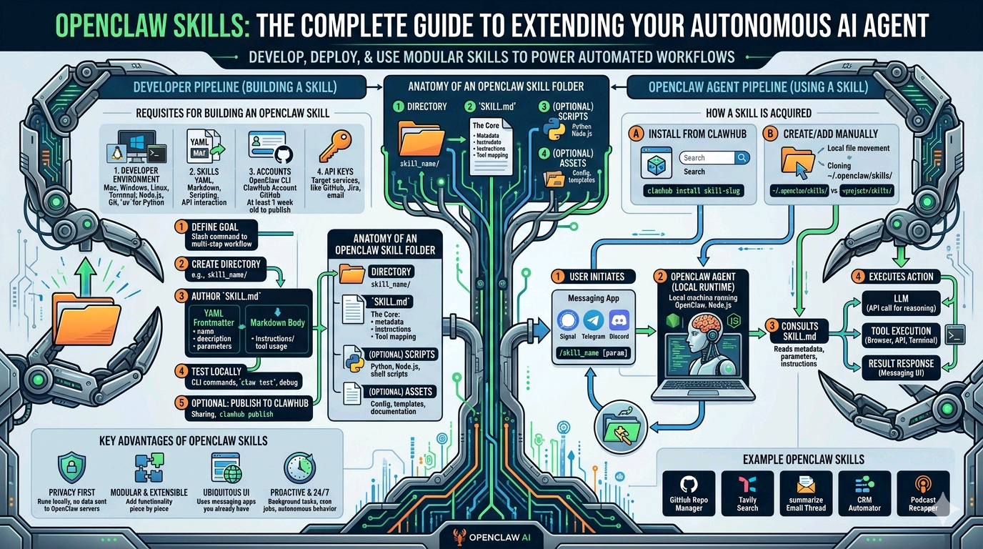
SKILLS
5
Notes:
Flow:
Step 1: Message arrives (or heartbeat/cron fires) → Gateway receives it.
Step 2: Gateway routes to correct session/agent → loads memory files + current context (If user hasn’t specified, its set by Orchestrator (main agent))
Step 3: Agent Core assembles full prompt → calls LLM → gets plan + tool calls. (Retrieves memory, check logs, workspace)
Step 4: Tools execute (locally or via sandbox) → results fed back into loop.
Step 5: Final response (Actions like code generation, App creation, device control, command terminals) (text, image, file, Canvas update) routed back via original channel. State (memory, history) persisted to disk.
Step6: Logs all the stuff into Session Log

Slide 7
SETUP
Setup & Hardware Requirements
💻
📦
🚀
Hardware
Software Stack
Quick Install
x86 PC or Mac (M-series preferred)
Minimum: 2-core CPU + 4 GB RAM
Recommended: 16 GB for multi-agent
Mac mini or VPS ideal (always-on)
One-liner for Mac/Linux:
curl -fsSL https://openclaw.ai
/install.sh | bash
Wizard: openclaw onboard --install-daemon
Node.js ≥ 22 (mandatory)
TypeScript-based CLI
Docker Compose (safest isolation)
Ollama for local models (optional)
📡 Channel onboarding via guided wizard: WhatsApp (QR scan) · Telegram (BotFather token) · Discord (OAuth2 portal)
Notes:
M series – chipset

Slide 8








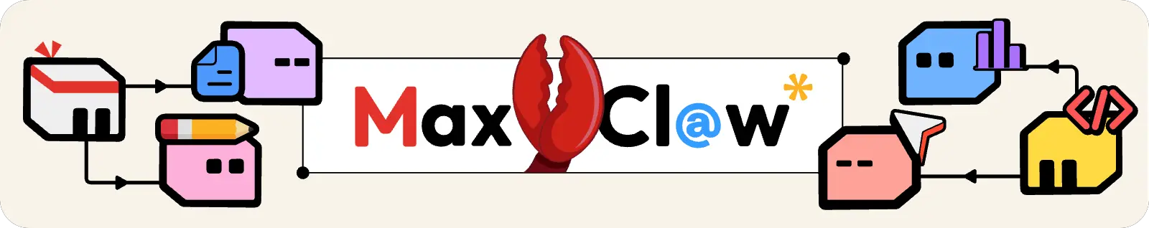
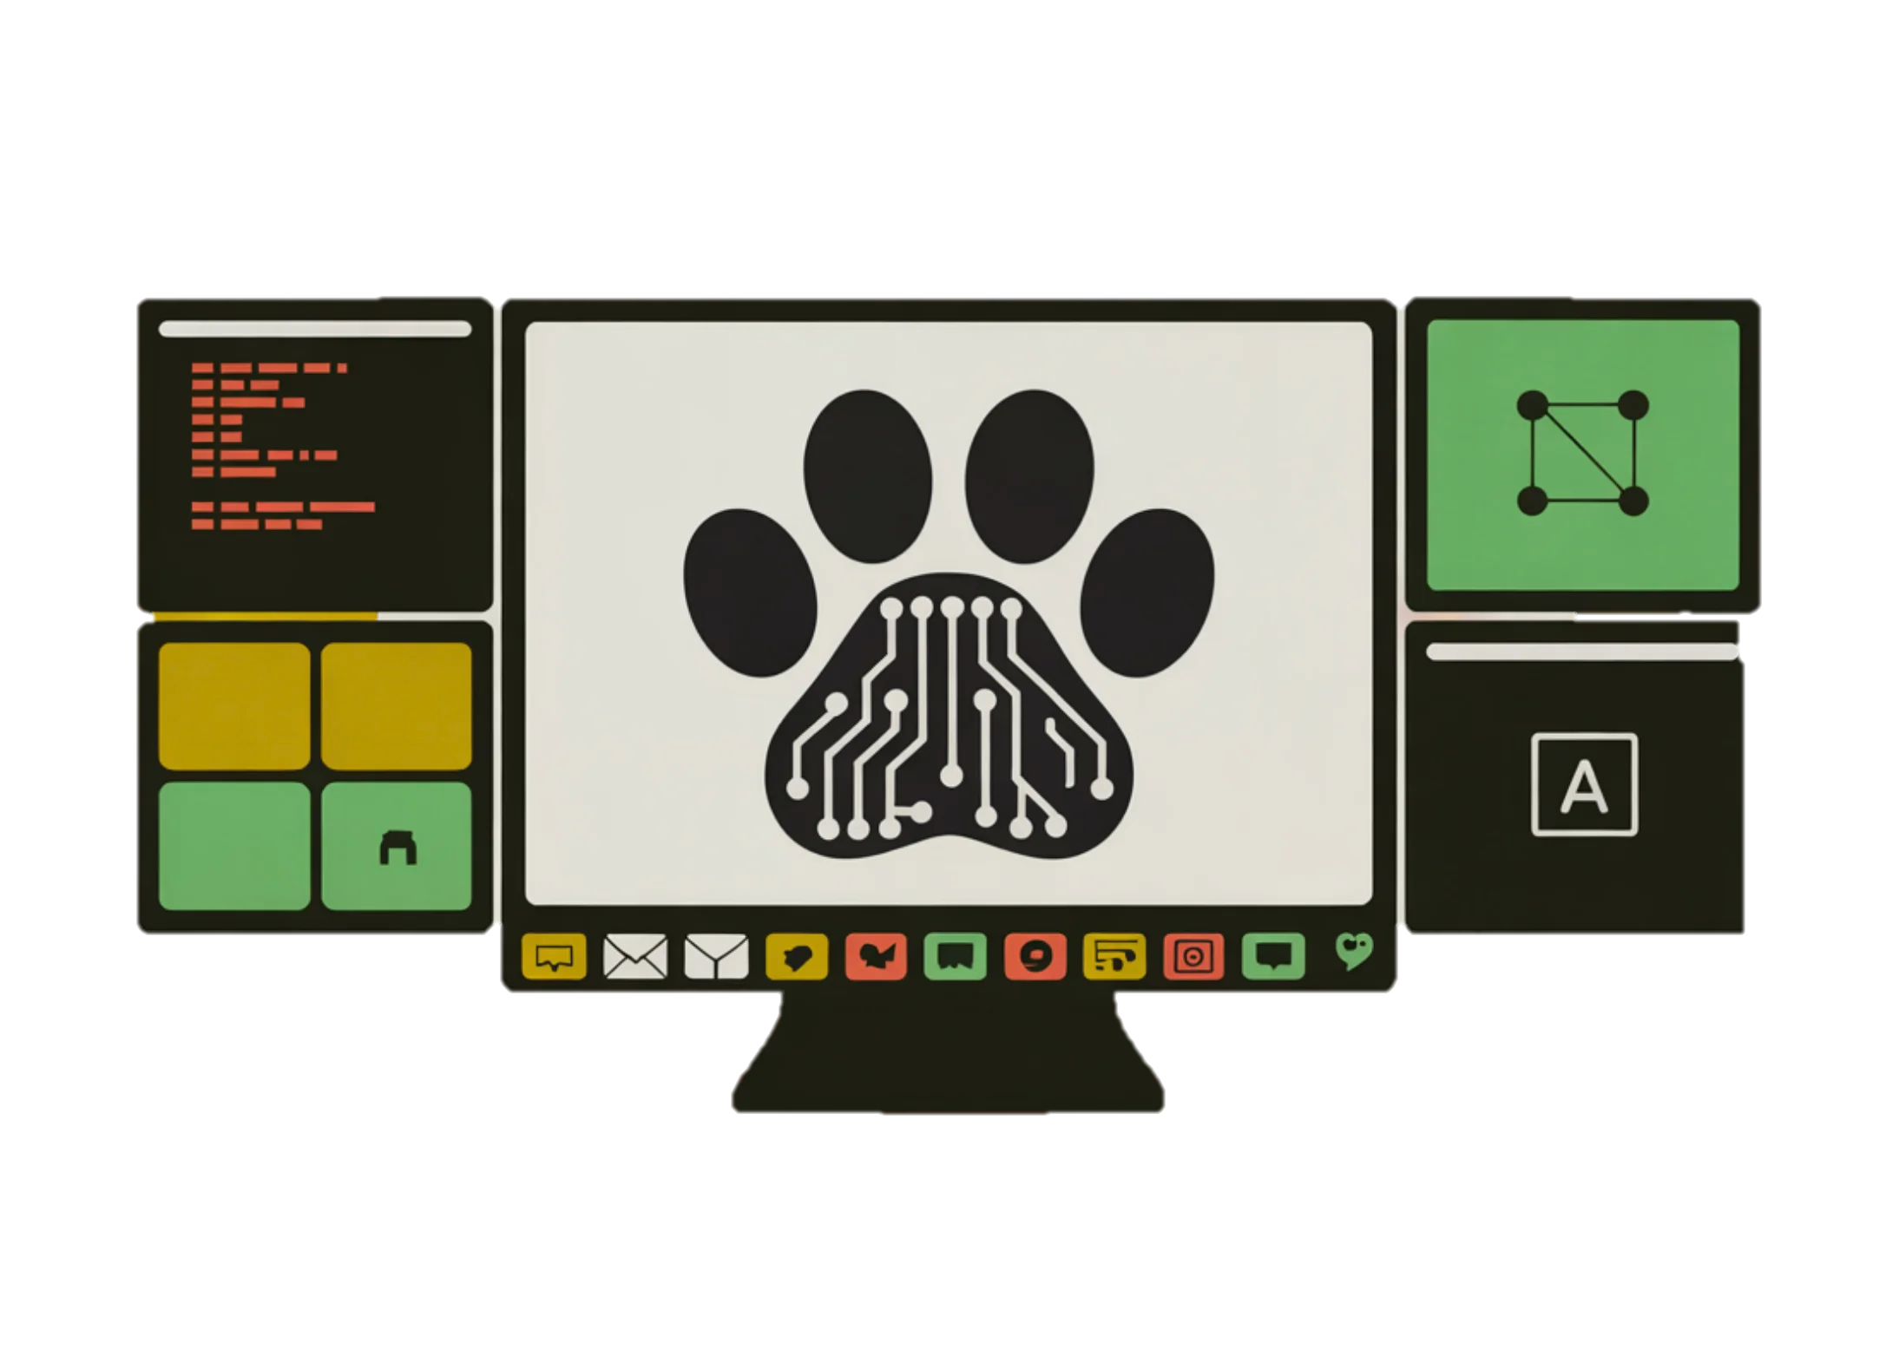



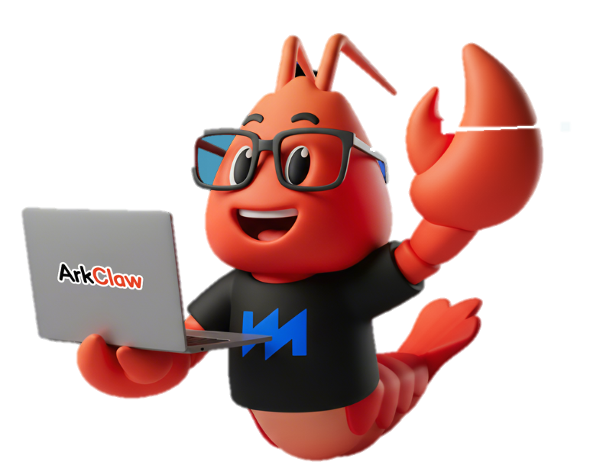




VARIANTS ECOSYSTEM
Open Source
Mobile-specific
Edge + Cloud
Cloud-specific
MiClaw
(Xiaomi)
(Sipeed)
(Minimax)
CoPaw
(Alibaba)
KimiClaw
(Moonshot AI)
ArkClaw
(ByteDance)
QClaw
(Tencent)
TuyaClaw
(Tuya Smart)
AutoClaw
(ZhipuAI)
EdgeClaw
(OpenBMB)
IronClaw
(Near AI)

Slide 9
| Tech Management, SRI-B
CLAWS
CLASH OF THE
Hackathon Briefing –
Theme, Timeline, Deliverables

Slide 10












Problem Statement
You are free to explore endless possibilities realized using Openclaw or any of the open-source variants of Openclaw, aligning to one of the three themes below. Here are some sample minimum viable problem statements to get you thinking. You can:
implement a solution to any relevant problem statement based on the broad themes given, or,
combine two or more given sample (or own) problem statements under a theme into a multi-faceted solution
do not limit yourself to the sample problem statements, you will be evaluated on novelty of the solution
Theme 1: GenAI Research
Theme 2: Daily Utility (Smartphones)
Theme 3: Productivity Platforms
What tools can you create to stay at the bleeding edge of technology and to find innovations you can adopt?
What tools can you create to add value to your daily routine and to delegate your tasks to the intelligent orchestrator?
What tools can you create to make your life at work easier and to make AI your best colleague?
Sample Problem Statements
Sample Problem Statements
Sample Problem Statements
Tech Sensing Assistant
Daily Commute Planner
Meeting Scribe & Prep-coach
The solution should:
sweep the internet on a daily basis
collect latest & relevant tech news from credible sources (news pages, YT verified channels, etc.) based on the fields/topics provided
collate findings (summary for each item & source link) in a structured docx report
mail it to a pre-defined list of addresses once every week
The solution should:
read a user’s calendar for upcoming appointments
connect to real-time traffic & transit information (e.g.: metro timings, city bus routes)
calculate optimal departure time, best route, & ETA for each appointment
push it via Telegram/Whatsapp to the user 30 min before the departure time
The solution should:
read the user’s calendar for online meetings scheduled
pro-actively prepare concise prep-material based on related mails, documents in its knowledge base, & the web
join the meeting as a silent attendee (Teams/Google Meet/any other similar platforms)
transcribe the audio and prepare detailed meeting minutes
GenAI Research Digest
Intelligent Customizer
Repository Analyzer & Build Feasibility Engine
The solution should:
query preprint servers like ArXiv & Github daily for latest papers & open-source repos related to GenAI
download relevant PDFs, generate concise methodology summary
push a formatted daily digest in a docx file to a pre-defined list of mail addresses once every week
The solution should:
have rules for phone behavior based on user location & time (e.g. minimalistic UI, silent behavior in office)
create personalized packs of wallpaper, notification settings, ringtones, volume settings etc. for each instance
sense user’s daily routine or current location & time and apply the corresponding pack
The solution should:
access GitHub repository links, parse, validate, & queue repos for processing. env & conducting unit tests
identify programming languages, frameworks, & structure output into frontend, backend, & database layers
automate setup (install dependencies) & run build commands/simulate builds, check for missing files or incomplete configurations, classify each repo as buildable, non-buildable, or buildable with fixes.

Slide 11
Hackathon Timeline
Team & Ideas Registration
First-round Final Submission
Second-round
Announcement
Final
Demo
Final
Result
24th April 2026
8th May 2026
15th May 2026
19th May 2026
24th May 2026
Finalize Theme
Idea submission
First-round Demo
Complete Implementation
1-week Evaluation
First-round Results Announcement
Hands-on Demo Video
Use Case Explanation

Slide 12

Hackathon Requirement & Submission
Phase 1: Registration Round
Week 1 (Deadline: 24th April EOD)
Phase 2: Implementation Round
Week 3 (Last date 8th May EOD)
Phase 3: Demo Submission
(19th May EOD)
How well can you devise a conceptual solution & specify its features, benefits, feasibility?
How well can you put your concept into code, and get it running without flaw?
How well can you unify your concept and implementation, present it, and get stakeholder buy-in?
Teams (Max 4/team): ./
Deliverables:
Detailed proposal about your solution including:
theme selected
problem statement(s) approached
detailed architecture of the designed solution
user stories & user journeys
planned development timeline
components used – platforms, libraries, variant of OpenClaw utilized
dependencies – API requirements, estimated compute, etc.
Evaluation Criteria
Relevance to theme & biz importance
Presentation & documentation
* Students must provide their official college e-mail id
Deliverables:
Video Demo
Documentation – PPT ( format will be provided)
Public GitHub repo – working, buildable & runnable code with readme in Windows or Android (include setup, build and run instructions)
.apk file (in case of a smartphone-focused implementation)
Skill.md files (if any were written by the team during implementation)
Memory implementation to the OpenClaw setup
Evaluation Criteria
Working Prototype / Functionality
User Experience (UI/UX, usability, novelty)
Teams: Top Teams from Phase 2
Deliverables:
Hands-on demo video (10 mins, 1 – 3 usage scenarios) and detailed implementation report including:
final architecture & system design
dependencies – APIs, tools, skill files (existing/newly written)
evaluation dataset & performance benchmarking results - define & demonstrate KPIs
impact of solution & future scope (expanded user journey with additional features & development plan)
detailed AI usage report
AI models/APIs used within the solution
AI service usage for preparing project artifacts as specified in AI Disclosure (E.g. AI model or API, Prompt, Input, Output etc.)
Final Evaluation Criteria
Working Prototype / Functionality – 35%
Technical Depth of Contribution – 25%
User Experience (UI/UX, usability, novelty) – 15%
Relevance to Theme & Biz Importance – 15%
Presentation & Documentation – 10%
Winners: Top Submissions Per Theme Based On Total Score

Slide 13





What’s in it for you?
Build Real AI Products
Recognition & Exposure
Work on on-device AI, platforms & next-gen mobile experiences
Showcase your ideas and stand out
PRISM Worklet Opportunities
Cash Rewards
Top performers get a chance to work on Samsung PRISM worklets as Virtual Interns
Win exciting cash prizes for top teams
Hands-on Practical Learning
Go from idea → prototype in a fast-paced hackathon

Slide 14
Thank You!
The registration is now open!
Find it here.

